Slide 1
LNG Safety Worldwide case studies

Slide 2
Case Study 1
East Ohio Natural Gas Company, Cleveland Ohio

Slide 3
Year of Occurrence : October 1944
Place : Cleveland, Ohio
The East Ohio Natural Gas Company experienced a failure of an LNG tank.
128 people perished in the explosion and fire.
The tank did not had a retaining wall, and it was made during world war II, when metal rationing was very strict.
The steel of the tank was made up of extremely low amount of nickel, which made the tank brittle when exposed to the extreme cold of LNG, and the tank ruptured, spilling LNG into the city sewer system.

Slide 4
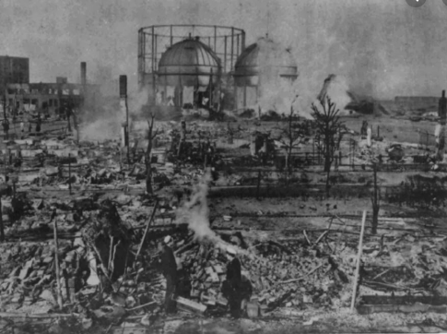
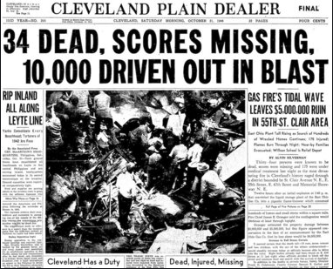

Slide 5
Description of Incident:
At 2:30 pm on Friday afternoon October 20, 1944, above ground storage tank number 4, holding liquefied natural gas in the East Ohio Gas Company’s tank farm, began to emit a vapor that poured from a seam on the side of the tank.
The tank was located near Lake Erie and winds from the lake pushed the vapor into mixed use section of Cleveland, where it dropped into the sewer lines via the catch basins located in the street gutters.
As the gas mixture flowed and mixed with air and sewer gas, the mix ignited.
In the ensuing explosion, manhole covers launched skyward as jets of fire erupted from depths of the sewer lines.

Slide 6
At first it was thought that the disaster was contained, and people returned home thinking the matter was being taken care by the fire department.
At 3:00 PM, a second above ground tank exploded, leveling the tank farm.
The explosions and fires continued to occur, trapping many who had returned to the safety of their homes.
Housewives found their homes suddenly engulfed in flames as the explosion travelled through the sewers and up through the drains.
Within split of seconds homes and clothes were on fire.

Slide 7
Lessons Learnt :
The explosion had a long range impact on the natural gas industry. Post disaster, the above ground storage system’s vulnerability was brought into light and below ground storage of NG grew in popularity.
Improper selection of material could be attributed to poor design.

Slide 8
Case Study 2
Texas Eastern Transmission Corporation(TETCO), Staten Island, New York

Slide 9
Year of Occurrence : February 1973
Place : Staten Island, NY, US
While repairing the interior of an empty storage tank, a fire started.
The pressure increased inside the tank so fast the concrete dome on the tank lifted and then collapsed falling inside the tank and killing 37 construction workers below.
No LNG was involved in this accident.

Slide 10
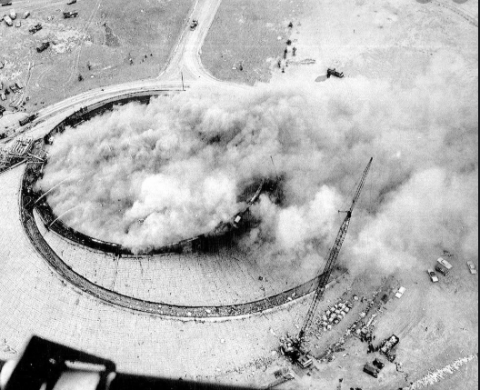

Slide 11
Description of Incident:
Proper precautions have been in place in all of the LNG facilities built and placed in service.
One of TETCO LNG storage tanks in staten island had been in service for over 3 years. It was taken out of service for repairs.
The tank was warmed, purged of the remaining combustible gases with inert nitrogen, and then filled with fresh recirculation air.
A construction crew entered to begin repair work in April 1972.
10 months later in Febrauary,1973, an unknown cause ignited the Mylar line and polyurethane foam insulation inside the tank.
Initial SOPs called for the use of explosion proof equipment within the tank; however non explosion proof irons or vacuum cleaners ignited the Mylar liner.
The rapid rise in temperature caused corresponding rise in pressure.
The pressure increase lifted the tank’s concrete dome.
The dome then collapsed, killing 37 construction workers inside.

Slide 12
Lessons Learnt :
While undertaking any maintenance work, all precautions should be taken.
The purging nitrogen might not have been done completely, as a result adequate neutralization of the enclosure has not been achieved.
For an explosion at any isolated location, 5% of natural gas concentration is enough.

Slide 13
Case Study 3
Cove Point LNG facility, Maryland

Slide 14
Year of Occurrence : October 1979
Place : Cove Point, Maryland,US
Lusby, Maryland, at the cove point LNG facility, a pump seal failed, releasing gas vapors, which entered and settled in an electrical conduit.
A worker switched off a circuit breaker, igniting the gas vapors, killing a worker and causing heavy damage to the building.

Slide 15
Description of Incident:
An explosion occurred within an electrical substation.
LNG leaked through LNG pump electrical penetration seal vaporized, passed through 200 feet of underground electrical conduit, and entered the substation.
Since no NG was expected in this building, gas detectors were not installed in the building.
The normal arcing contacts of a circuit breaker ignited the natural gas-air mixture resulting in an explosion in LNG regasification terminal.
The explosion killed one operator, seriously injuring other and causing $3 million damages.

Slide 16
Lessons Learnt :
All possible leakage point from LNG tank should be check listed for isolation compliance.
National fire codes were changed as a result of the accident.

Slide 17
Case Study 4
Sonatrach LNG liquefaction facility, Algeria

Slide 18
Year of Occurrence : January 2004
Place : Skikda, Algeria
Explosion at Sonatrach LNG liquefaction facility killed 27, injured 80, destroyed 3 LNG trains.
Production was down to 76% for the year.
A cold H/C leak occurred and hydrocarbon gases were drawn into the combustion air for a high pressure steam boiler.
The explosion inside the boiler fire box precipitated a larger explosion of vapors outside the box.

Slide 19
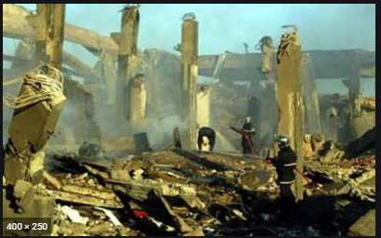
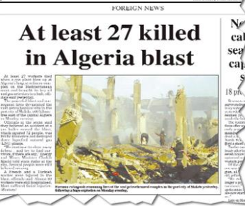

Slide 20
Description of Incident:
A steam boiler that was part of an LNG liquefaction production plant exploded, triggering a second more massive vapor cloud explosion and fire that took eight hours to extinguish.
The explosions and fire destroyed a portion of the LNG plant and caused death, injury and material damage outside the plant’s boundaries.
Sonatrach, government owned oil company, owns the skikda LNG liquefaction plant.
The plant had 6 LNG producing unit called “trains”, storage tanks and other buildings.
The plant uses steam boilers to make high pressure steam for its steam turbines.
These turbines supply power to the plants refrigerant compressors that liquefy the NG.

Slide 21
The explosion of the gas vapor cloud occurred between two sections of one production train :
Where natural gas liquids(C3 and C2) are separated from methane. And
Where methane is liquefied. Fire destroyed three LNG trains, but no damage was done on any LNG storage tanks or the remaining 3 trains.
27 people were killed and 56 were wounded.

Slide 22
Lessons Learnt :
All possible leakage point from LNG tank should be checklisted for isolation compliance.
The LNG liquefaction plant being very vulnerable for leakages, the gas detectors should be placed at all locations where such concentrations can lead to explosion on fire.

Slide 23
